Slide 1
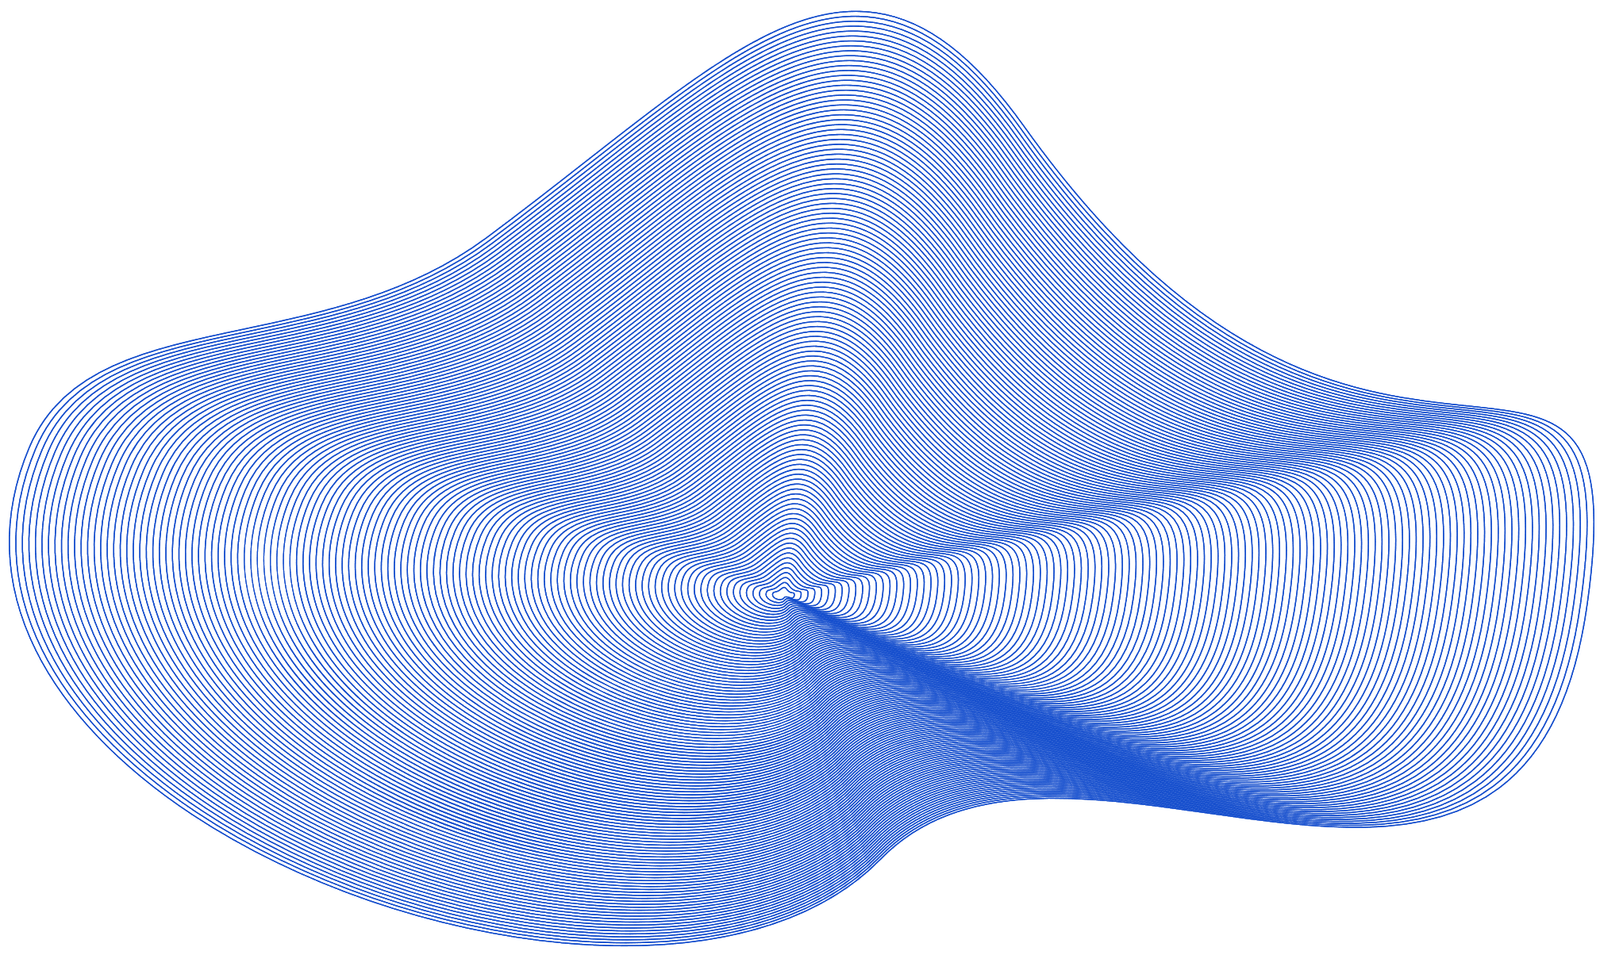
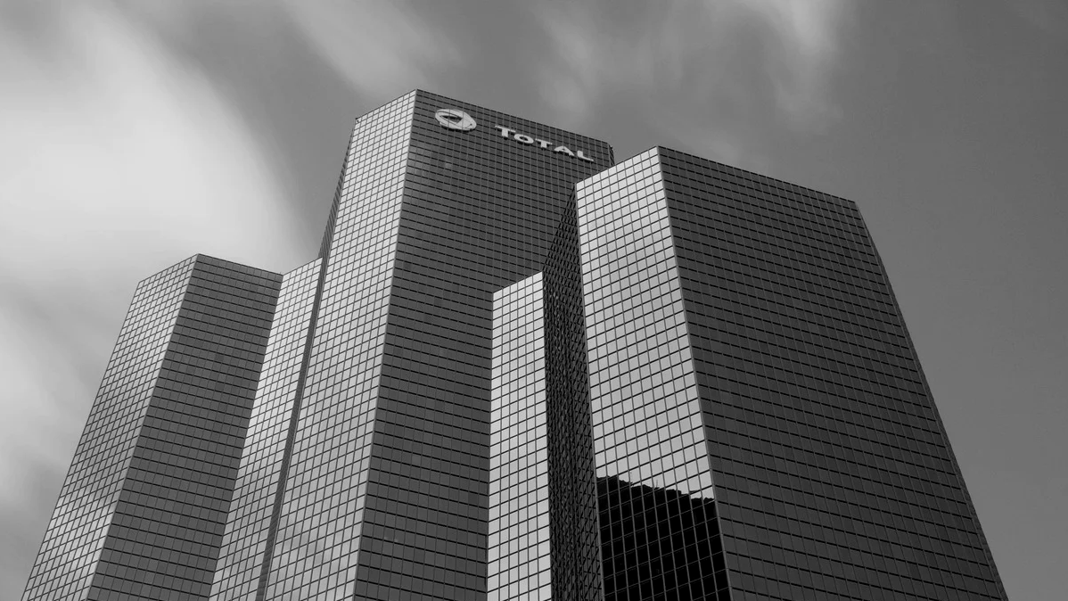

COMPANY TIMELINE
Infraestrutura
de
Datacenter

Slide 2
Requisitos
Infraestrutura local
Colocation
Nuvem
Espaço: Adequado para abrigar servidores, racks, e equipamentos de rede.
Energia: UPS e geradores.
Resfriamento: Arcondicionado split inverter.
Segurança Física: Controle de acesso.
Conectividade: Conexões de internet de alta velocidade.
Equipamentos de Rede: Switche e roteador
Espaço: Alugado de Datacenter de Terceiros medidos em U.
Servidores: Enviados para o datacenter ocupando local alugado. Todo o ambiente é controlado pela empresa contratada.
Espaço: Inexistente.
Conectividade: Necessita de boa conectividade.

Slide 3
Comparação
Infraestrutura local
Colocation
Nuvem
Custo de implementação Alto
Controle Total
Latência baixa
Escalabilidade Dificultada
Riscos
Dependência de energia e Climatização controladas.
Interferências climaticas.
Custo de implementação Médio
Custos constantes
Flexibilidade
Escalabilidade média
Latência baixa/média
Riscos
Dependência de terceiros.
Interferências climaticas.
Custo de implementação Baixo
Custo variavel baseado no uso
Disponibilidade facilitada
Escalabilidade fácil
Latência média/elevada
Riscos
Dependência de conectividade
Serviço de terceiros indisponível.

Slide 4
Infraestrutura local
Servidor de banco de dados pela DELL:
Processador: AMD EPYC 9254 de 2,90 GHz.
Memória: SSD de 960GB SATA RI 6Gbps 512 2.5“.
- Amazenamento: SSD de 960GB SATA RI 6Gbps.
Servidor de backup de banco de dados pela DELL:
- Processador: AMD EPYC 9124 16 núcleos/32 threads.
- Memória: RDIMM de 16 GB, 4.800 MT/s
Amazenamento: SSD de 960GB SATA RI 6Gbps
Servidor de aplicação DELL:
Processador: Intel® Xeon® Silver 4416+ 2G, 20C/40T
Memória : 2x 16GB RDIMM, 4800MT/s, Single Rank 16Gb Base x8
- Amazenamento: 960GB SSD SATA Read Intensive 6Gbps
3 Servidores de pequeno porte DELL:
Processador: Intel® Xeon® E-2324G 3.1 GHz, 8M Cache, 4 núcleos/4 threads
Memória :8GB DDR4 3200MHz (1X8GB, ECC, UDIMM, BCC)
- Amazenamento:HD de 2TB SATA 6Gbps 7.2K 512n 3.5" Cabled.

Slide 5
Infraestrutura Local
Links
Servidor de banco de dados pela DELL:
https://www.dell.com/pt-br/shop/cty/pdp/spd/poweredge-r7625/pe_r7625_15972_bcc_1?tfcid=31768715&gacd=9687031-14063-5761040-273175705-0&dgc=ST&gad_source=1&configurationid=fca6b943-0721-4416-ad4e-2f7d44e95a93
Servidor de backup de banco de dados pela DELL:
https://www.dell.com/pt-br/shop/cty/pdp/spd/poweredge-r7625/pe_r7625_15972_bcc_1?tfcid=31768715&gacd=9687031-14063-5761040-273175705-0&dgc=ST&gad_source=1&configurationid=96a1c86e-5f4f-4119-926b-95daff09a9af
Servidor de aplicação DELL:
https://www.dell.com/pt-br/shop/servidores-armazenamento-rede/servidor-rack-poweredge-r760xs/spd/poweredge-r760xs/pe_r760xs_16830_bcc_1?gacd=9687031-14063-5761040-273175705-0&dgc=ST&gad_source=1&configurationid=a1252161-e818-4eeb-9ff1-b9c7cc0ba3db
3 Servidores de pequeno porte DELL:
-https://www.dell.com/pt-br/shop/servidores-armazenamento-rede/servidor-rack-poweredge-r250/spd/poweredge-r250/pe_r250_15318_bcc_1?configurationid=d04c062e-bc99-4c8f-88f3-255ddf7a4061
Sistema linux debian link:
- https://www.debian.org/

Slide 6
Infraestrutura Colocation
Servidor de banco de dados pela DELL:
Processador: AMD EPYC 9254 de 2,90 GHz.
Memória: SSD de 960GB SATA RI 6Gbps 512 2.5“.
- Amazenamento: SSD de 960GB SATA RI 6Gbps.
Servidor de backup de banco de dados pela DELL:
- Processador: AMD EPYC 9124 16 núcleos/32 threads.
- Memória: RDIMM de 16 GB, 4.800 MT/s
Amazenamento: SSD de 960GB SATA RI 6Gbps
Servidor de aplicação DELL:
Processador: Intel® Xeon® Silver 4416+ 2G, 20C/40T
Memória : 2x 16GB RDIMM, 4800MT/s, Single Rank 16Gb Base x8
- Amazenamento: 960GB SSD SATA Read Intensive 6Gbps
3 Servidores de pequeno porte DELL:
Processador: Intel® Xeon® E-2324G 3.1 GHz, 8M Cache, 4 núcleos/4 threads
Memória :8GB DDR4 3200MHz (1X8GB, ECC, UDIMM, BCC)
- Amazenamento:HD de 2TB SATA 6Gbps 7.2K 512n 3.5" Cabled.

Slide 7
Infraestrutura Colocation
Links
Servidor de banco de dados pela DELL:
https://www.dell.com/pt-br/shop/cty/pdp/spd/poweredge-r7625/pe_r7625_15972_bcc_1?tfcid=31768715&gacd=9687031-14063-5761040-273175705-0&dgc=ST&gad_source=1&configurationid=fca6b943-0721-4416-ad4e-2f7d44e95a93
Servidor de backup de banco de dados pela DELL:
https://www.dell.com/pt-br/shop/cty/pdp/spd/poweredge-r7625/pe_r7625_15972_bcc_1?tfcid=31768715&gacd=9687031-14063-5761040-273175705-0&dgc=ST&gad_source=1&configurationid=96a1c86e-5f4f-4119-926b-95daff09a9af
Serviço de Colocation:
https://masterdaweb.com/colocation/
Servidor de aplicação DELL:
https://www.dell.com/pt-br/shop/servidores-armazenamento-rede/servidor-rack-poweredge-r760xs/spd/poweredge-r760xs/pe_r760xs_16830_bcc_1?gacd=9687031-14063-5761040-273175705-0&dgc=ST&gad_source=1&configurationid=a1252161-e818-4eeb-9ff1-b9c7cc0ba3db
3 Servidores de pequeno porte DELL:
-https://www.dell.com/pt-br/shop/servidores-armazenamento-rede/servidor-rack-poweredge-r250/spd/poweredge-r250/pe_r250_15318_bcc_1?configurationid=d04c062e-bc99-4c8f-88f3-255ddf7a4061
Sistema linux debian link:
- https://www.debian.org/

Slide 8
Nuvem
Aws
Google
Oracle
Primeira Maquina – c6a.8xlarge, 32 vCPUs, 64Gib de memoria, desempenho da rede de 12500 Megabit e SSD gp2 -> 521.42 USD Segunda Maquina – c4.4xlarge, 16 vCPUs, 30 Gib de memoria, e 700 Gb de armazenamento -> 367.11 USD
Terceira Maquina – c4.xlarge, 4 vCPUs, 7.5Gib de memoria, 60 Gb de armazenamento * 5 -> 402.30 USD Quarta Maquina - c6x.large, 4 vCPUs, 8 Gib de ram e 150 Gb de armazenamento * 3 -> 187.79 USD
Primeira Maquina – Custom Machine, 24 vCPUs, 40Gib de memoria, 2x375 GB de armazenamento, instance - time 730 hours-> 1224,40 USD Segunda Maquina – Custom Machine, 10 vCPUs, 16Gib de memoria, 2x375 GB de armazenamento, instance - time 730 hours-> 557,05 USD
Terceira Maquina – Custom Machine, 18 vCPUs, 25Gib de memoria, 1x375 GB de armazenamento, instance - time 730 hours-> 871,30 USD Quarta Maquina - Custom Machine, 4 vCPUs, 8 Gib de memoria, 1x375 GB de armazenamento, instance - time 2190 hours-> 1224,40 USD
Primeira Maquina – AMD, VM.Standart.E4.flex, 24 vCPUs, 40Gib de memoria, armazenamento de 700 Gb, Utilization 744 hours/month
-> 297,59 USD
Segunda Maquina – AMD, VM.Standart.E4.flex, 10 vCPUs, 16b de memoria, armazenamento de 700 Gb, Utilization 744 hours/month -> 140.61 USD
Terceira Maquina – AMD, VM.Standart.E4.flex, 18 vCPUs, 25b de memoria, armazenamento de 300 Gb, Utilization 744 hours/month -> 208.05 USD Quarta Maquina - AMD, VM.Standart.E4.flex, 4 vCPUs, 8b de memoria, armazenamento de 150 Gb, Utilization 744 hours/month * 3-> 157.5 USD

Slide 9

Creditos
Alunos
- Lucas Souza Pereira – 01224070
- Pedro Henrique Félix da Fonseca - 01528288
- Ewerton Rosendo da Silva - 01510422
- Lidyce Amanda Gomes de Oliveira – 01550458
- Alanis Pereira da Silva - 01535211

Slide 10

Obrigado!

Slide 11
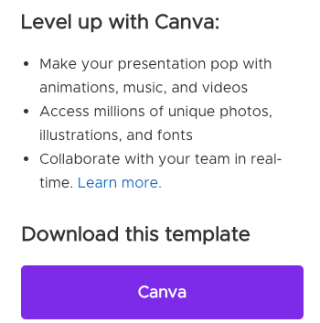
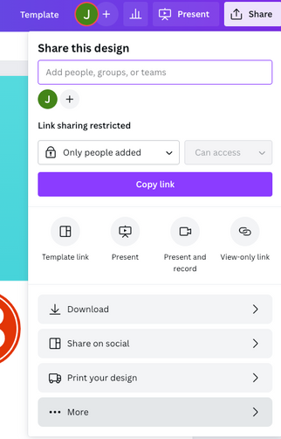
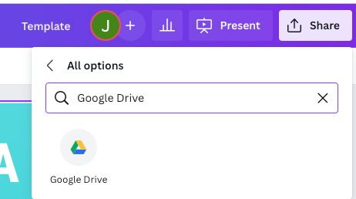
Download this presentation as a
Google Slide template in 3 steps
01
Click on the "Canva" button next
to this presentation. Start editing your presentation. You may need
to sign in to your Canva account.
02
Click on the "Share" button
on the top right corner in
Canva and click on "More"
at the bottom of the menu.
03
Enter "Google Drive" in the search
bar and click on the Google Drive icon to add this design as a Google slide in your G Drive. It will ask you
to link your Google account to
Canva the first time.

Slide 12

Add an Agenda Page
01 | Write an agenda here.
02 | Write an agenda here.
03 | Write an agenda here.
04 | Write an agenda here.
05 | Write an agenda here.

Slide 13

Add a Timeline Page
01
02
03
04
Add a main point
Add a main point
Add a main point
Add a main point
Elaborate on what
you want to discuss.
Elaborate on what
you want to discuss.
Elaborate on what
you want to discuss.
Elaborate on what
you want to discuss.

Slide 14


01
02
03
2015
2016
2017
Add a main point
Add a main point
Add a main point
Elaborate on what
you want to discuss.
Elaborate on what
you want to discuss.
Elaborate on what
you want to discuss.
04
05
2018
2019
Add a main point
Add a main point
Elaborate on what
you want to discuss.
Elaborate on what
you want to discuss.
Add a Timeline Page

Slide 15


2016
Add a main point
Elaborate on what
you want to discuss.
2017
Add a main point
Elaborate on what
you want to discuss.
2019
Add a main point
Elaborate on what
you want to discuss.
2015
Add a main point
Elaborate on what
you want to discuss.
2018
Add a main point
Elaborate on what
you want to discuss.
Add a Timeline Page

Slide 16

2015
01
Add a main point
Elaborate on what you want to discuss.
Add a
Timeline
Page
Add a main point
02
2016
Elaborate on what you want to discuss.
03
Add a main point
2017
Elaborate on what you want to discuss.
Add a main point
04
2018
Elaborate on what you want to discuss.
05
Add a main point
2019
Elaborate on what you want to discuss.

Slide 17

Add a Timeline Page
2016 | 2018 | 2020 | Present
Add a main point | Add a main point | Add a main point | Add a main point
Elaborate on what you want to discuss. | Elaborate on what you want to discuss. | Elaborate on what you want to discuss. | Elaborate on what you want to discuss.

Slide 18

Add a Timeline Page
2016
2018
01
Add a main point
03
Add a main point
05
Elaborate on what
you want to discuss.
Elaborate on what
you want to discuss.
2015
2017
2019
02
04
Add a main point
Add a main point
Add a main point
Elaborate on what
you want to discuss.
Elaborate on what
you want to discuss.
Elaborate on what
you want to discuss.

Slide 19



Write your topic or idea
Add a main point
Add a main point
Add a main point
Briefly elaborate on what
you want to discuss.
Briefly elaborate on what
you want to discuss.
Briefly elaborate on what
you want to discuss.

Slide 20

Hello
there!
I'm Rain, and I'll be sharing with you my beautiful ideas.
Follow me at @reallygreatsite to learn more.

Slide 21
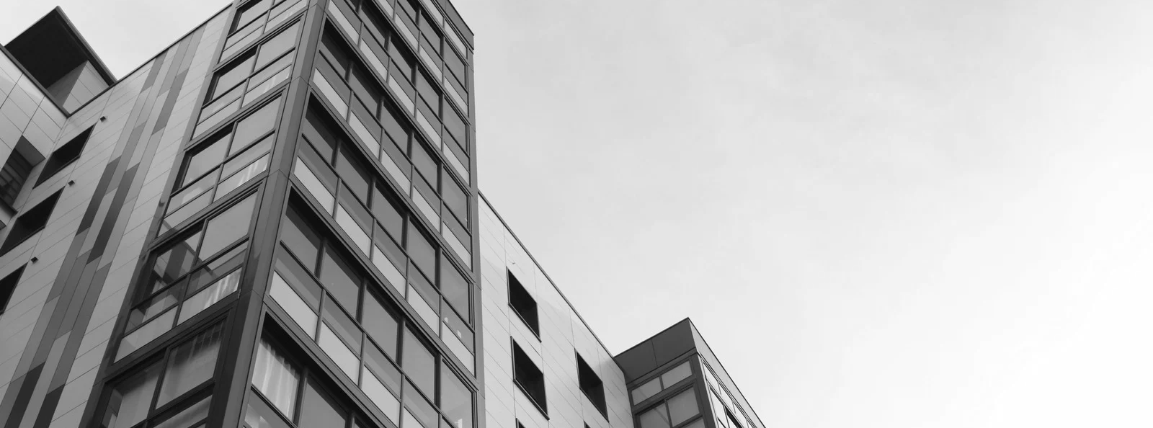

Write Your Topic or Idea
Elaborate on what you want to discuss.

Slide 22

Add a main point
Elaborate on what you
want to discuss.
Write Your Topic or Idea
Add a main point
Elaborate on what you
want to discuss.
Add a main point
Elaborate on what you
want to discuss.

Slide 23
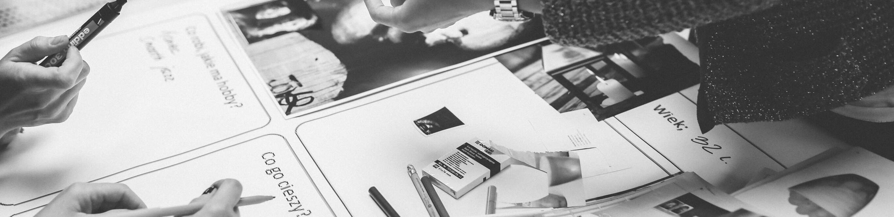



Write Your Topic or Idea
Add a main point
Add a main point
Add a main point
Elaborate on what you
want to discuss.
Elaborate on what you
want to discuss.
Elaborate on what you
want to discuss.

Slide 24


Write a
Heading Here

Slide 25

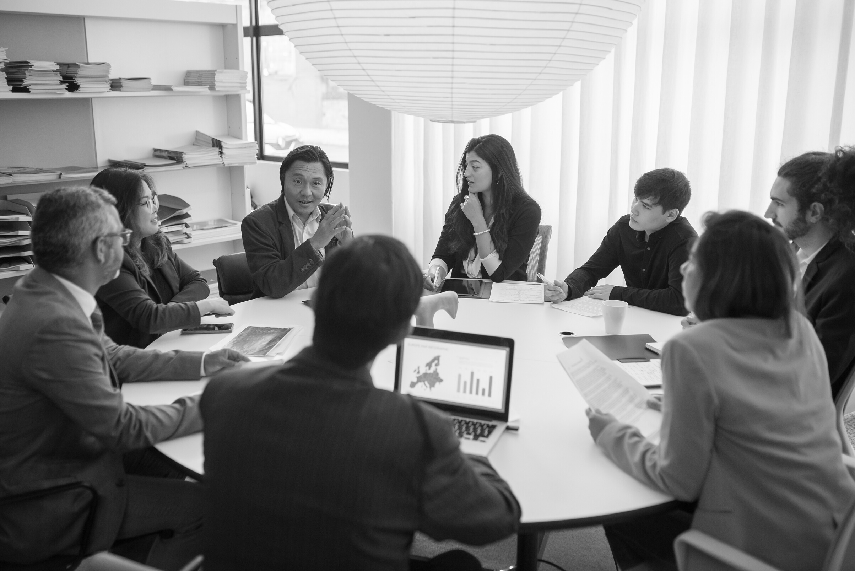

Write a caption for the photos.

Slide 26
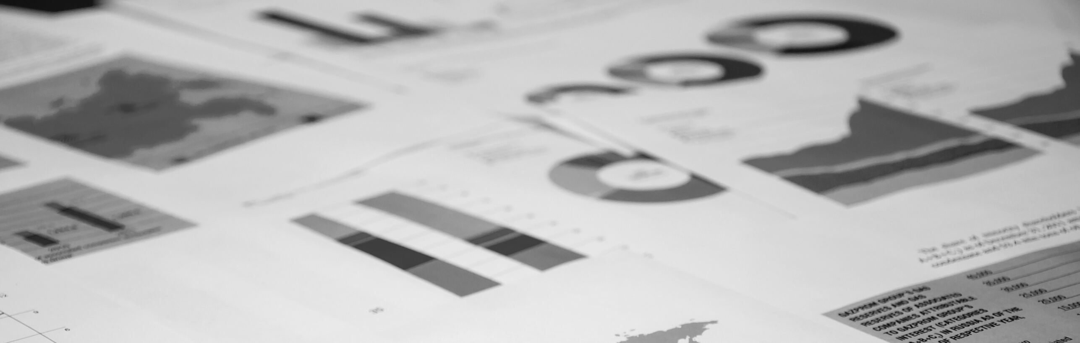
Write an original statement or
inspiring quote
Include a credit, citation, or
supporting message

Slide 27


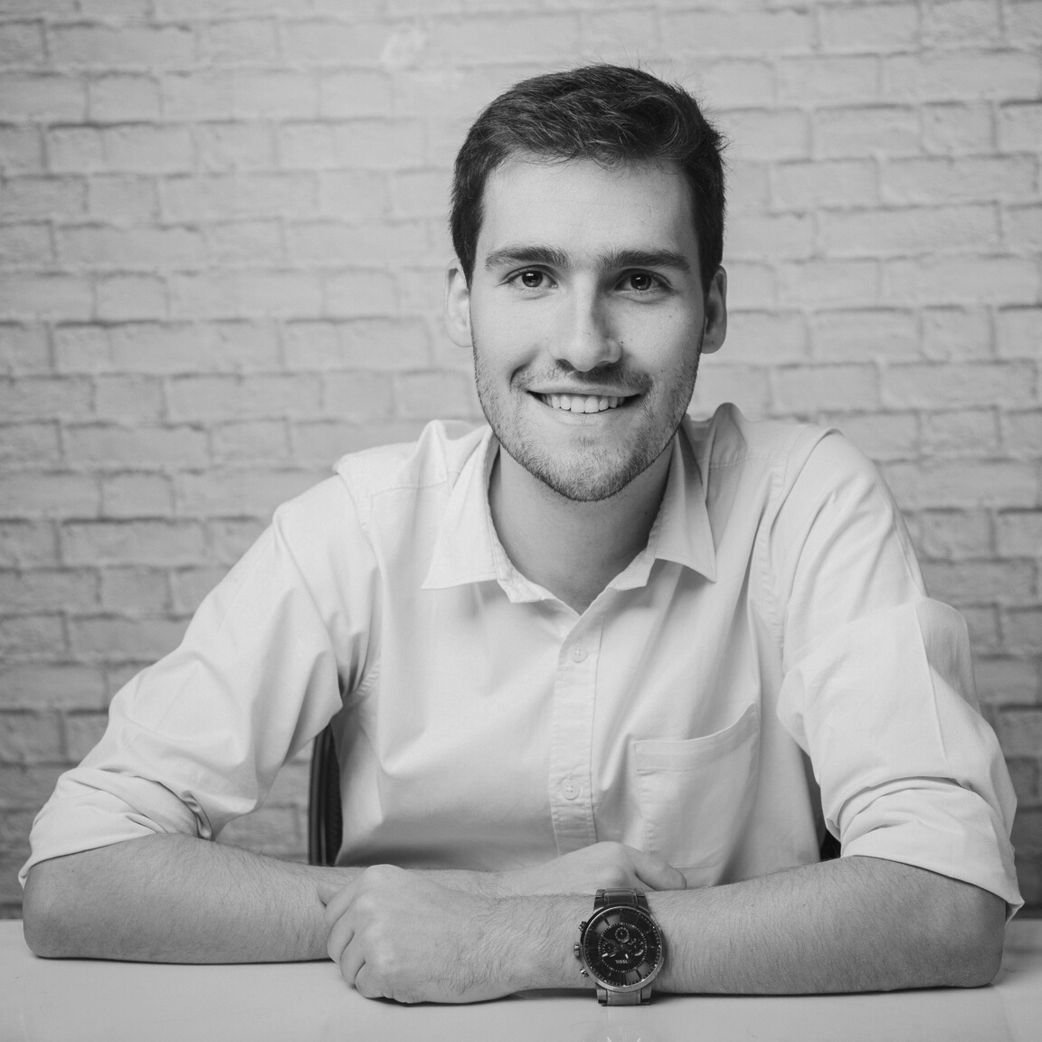
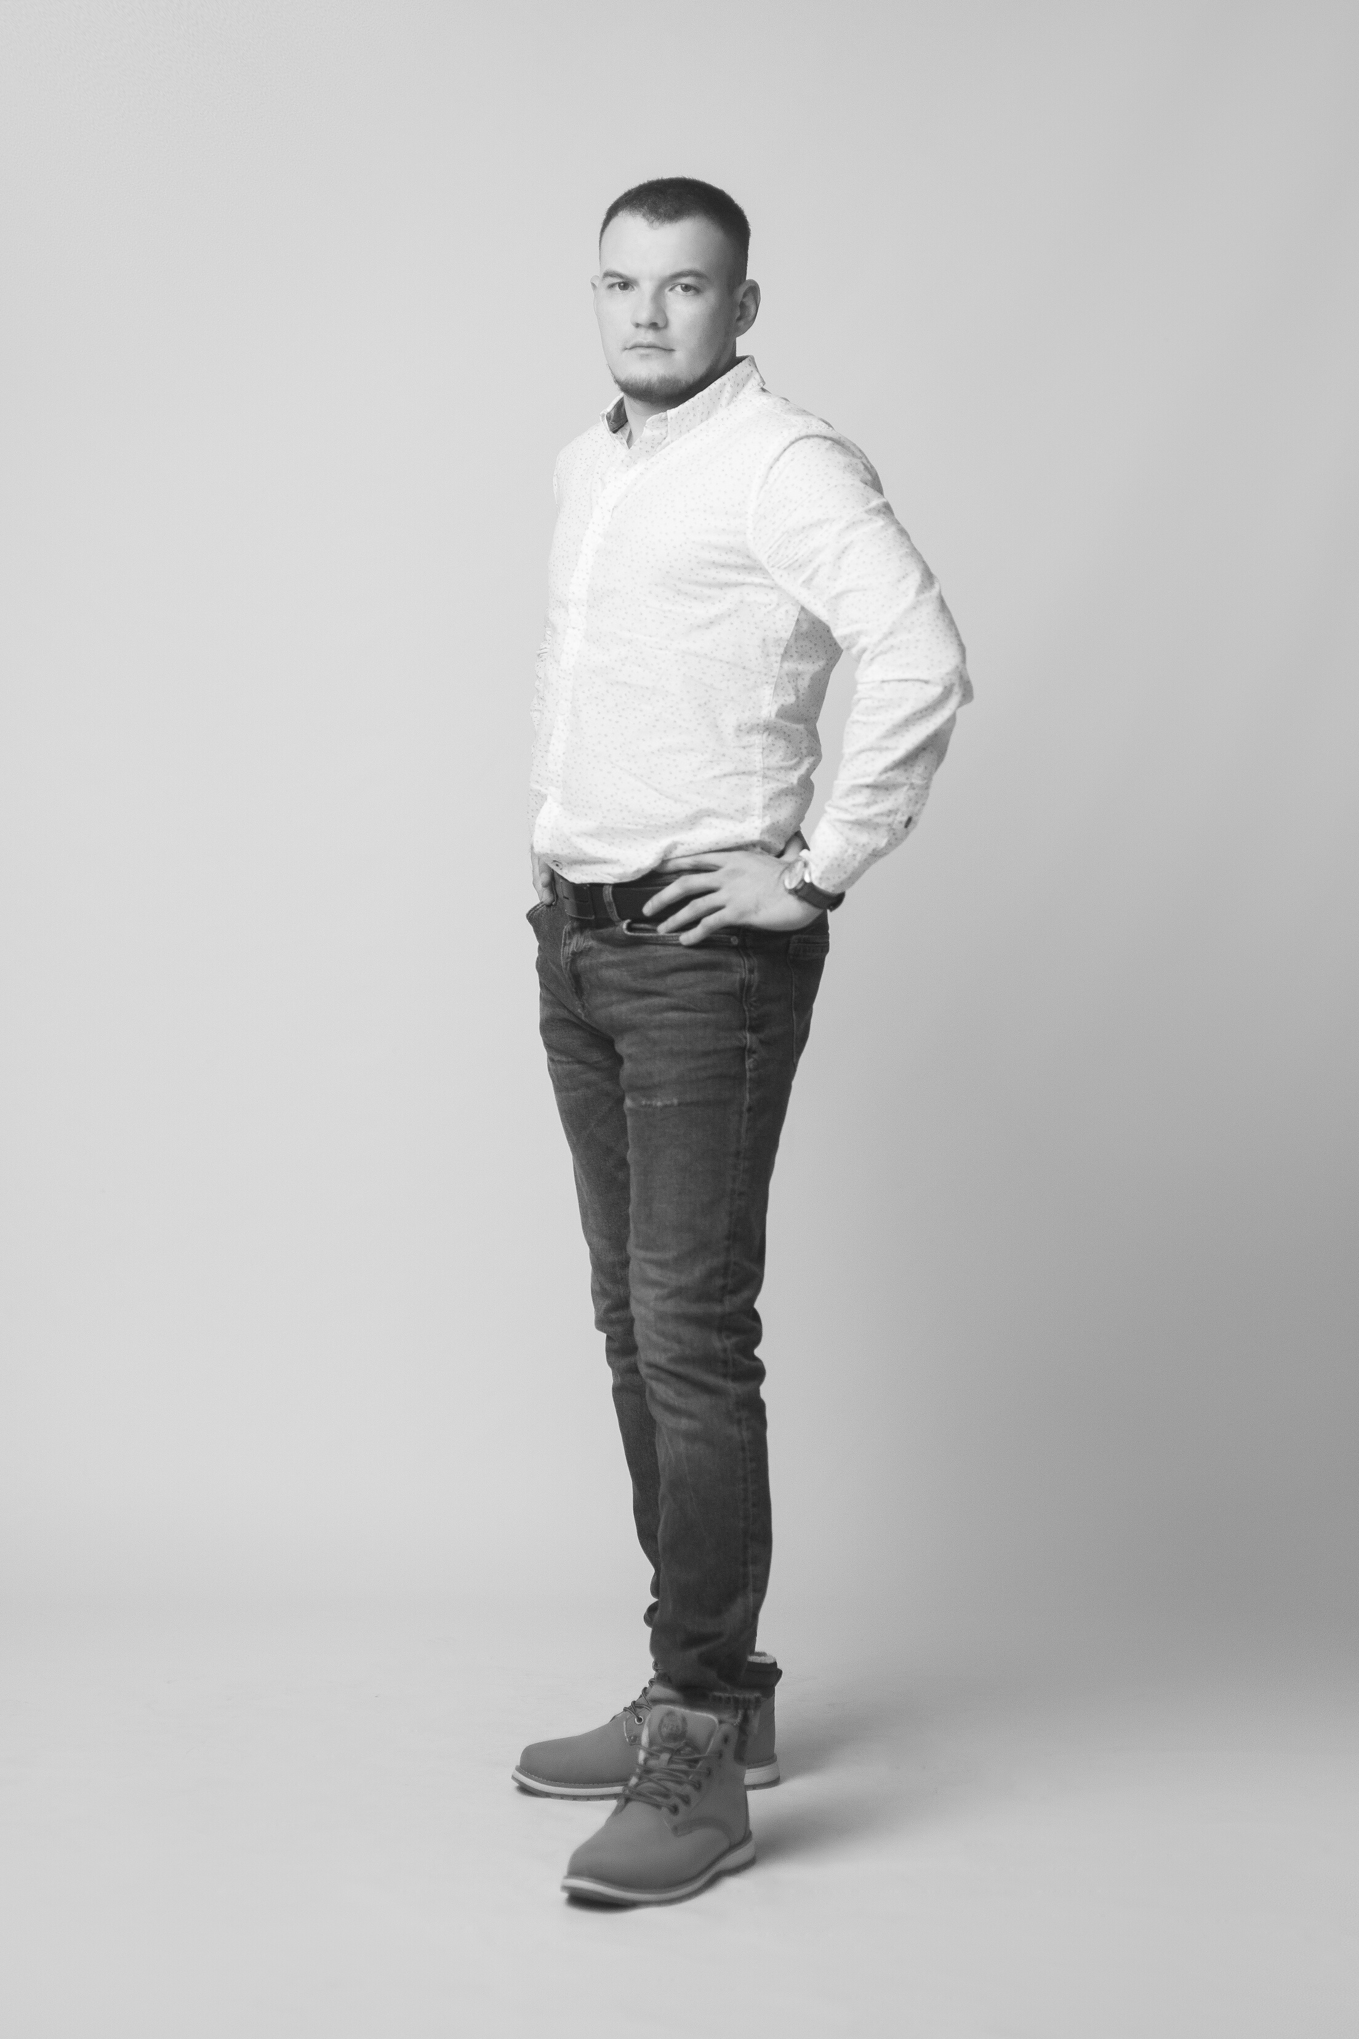
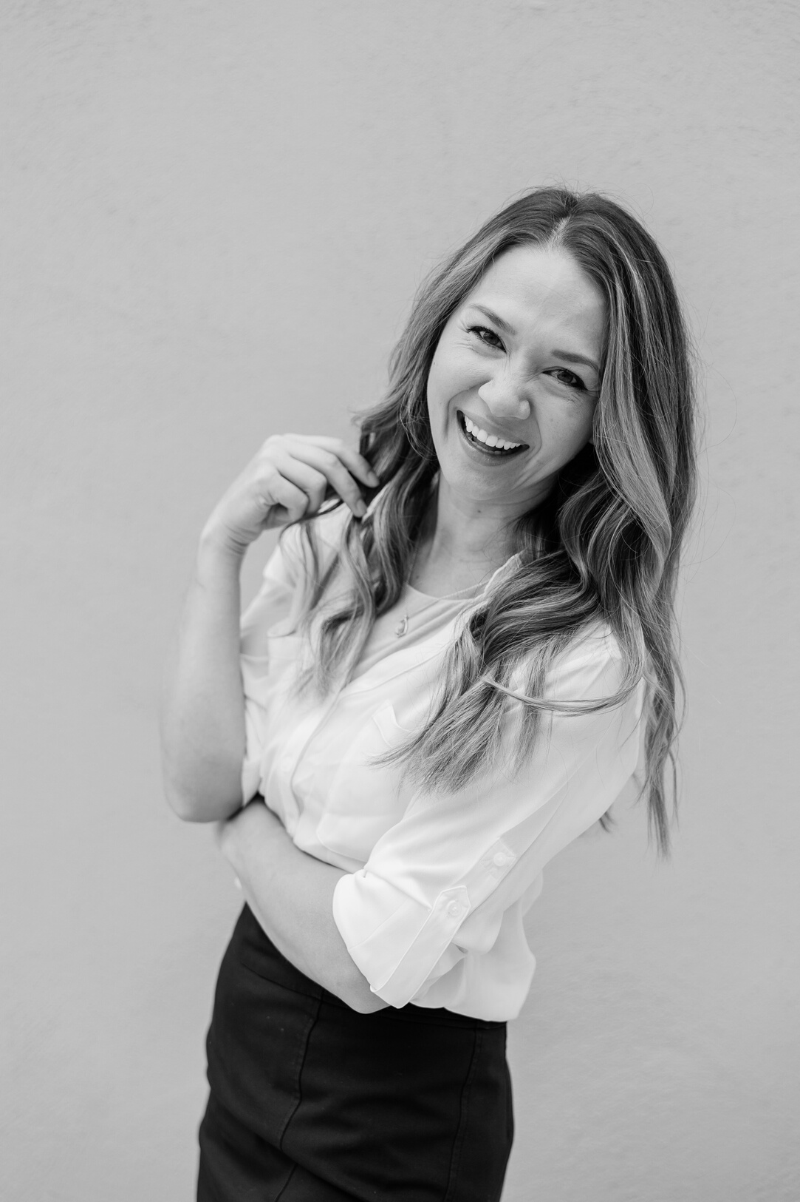
Add a Team Members Page
Elaborate on what you want to discuss.
Name
Name
Name
Name
Title or Position
Title or Position
Title or Position
Title or Position

Slide 28


Add a Team Members Page
Elaborate on what you want to discuss.
Name
Name
Name
Name
Title or Position
Title or Position
Title or Position
Title or Position

Slide 29

02
Add a
Section Header

Slide 30

Write Your Big Topic or Idea
Elaborate on what you want to discuss.

Slide 31

Write Your
Topic or Idea

Slide 32

123,456,789
Elaborate on the featured statistic.

Slide 33




2 out of 5
75%
12 million
Elaborate on the
featured statistic.
Elaborate on the
featured statistic.
Elaborate on the
featured statistic.

Slide 34
Fonts In this Presentation
This presentation template uses the following free fonts:
Titles: Agrandir Wide Thin
Headers: Agrandir Wide Thin
Body Copy: DM Sans
You can find these fonts online too. Happy designing!

Slide 35

S
W
STRENGTHS | What are you doing well? What sets you apart? What are your good qualities?
WEAKNESSES | Where do you need to improve? Are resources adequate? What do others do better than you?
OPPORTUNITIES | What are your goals? Are demands shifting? How can it be improved?
THREATS | What are the blockers you're facing? What are factors outside of your control?
STRENGTHS
WEAKNESSES
O
T
OPPORTUNITIES
THREATS

Slide 36

Write Your Topic or Idea
Elaborate on what you want to discuss.

Slide 37
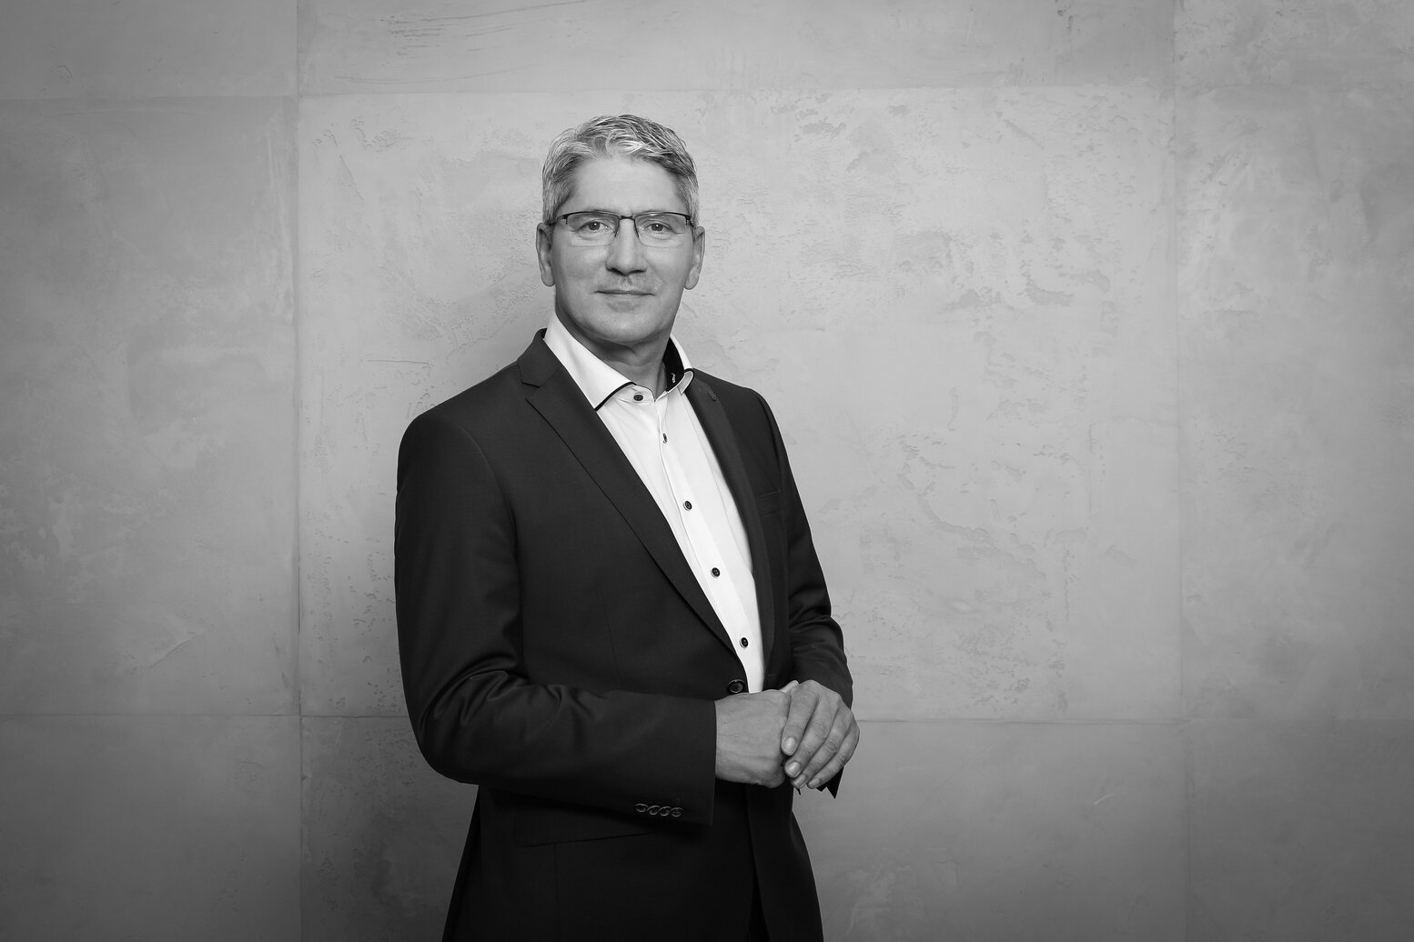

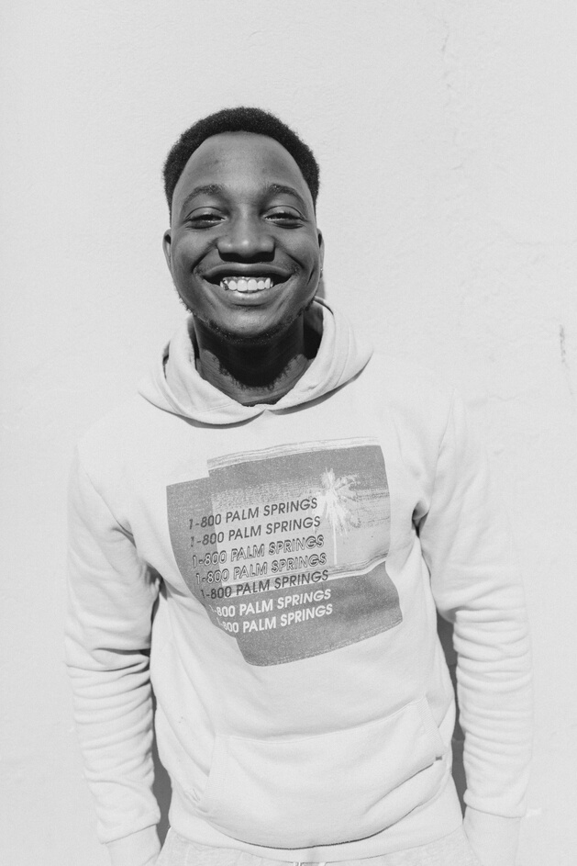
Add a Chart Page
Elaborate on what you want to discuss.
Name
Job Title
Name
Name
Job Title
Job Title
Name
Name
Name
Name
Job Title
Job Title
Job Title
Job Title

Slide 38









Resource
Page
Use these design resources in your Canva Presentation. Happy designing!
Don't forget to delete this page before presenting.

Slide 39






Resource
Page
Use these design resources in your Canva Presentation. Happy designing!
Don't forget to delete this page before presenting.

Slide 40




Free templates for all
your presentation needs
FREE
For PowerPoint, Google Slides,
and Canva
100% free for personal or commercial use
Ready to use, professional,
and customizable
Blow your audience away with
attractive visuals

